Slide 1
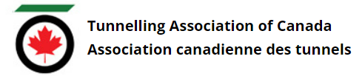
Tunnelling Association of Canada
Equity, Diversity, and Inclusion Moment
Listening and Understanding

Slide 2

Tunnelling Association of Canada
Listening Effectively
Listening effectively means being attentive to the speaker, understanding what they’re saying, reflecting on what’s being said, and retaining the information for later.
Effective listening means going beyond hearing the words that are being spoken; seek to understand the meaning and intent behind them.
2

Slide 3
Tunnelling Association of Canada
How to practice effective listening?
Give your sole focus to the person speaking
  Put away your cell phone, ignore distractions, and avoid daydreaming
  Maintain good eye contact (find a happy medium between constant eye contact and not paying attention)
Use and understand non-verbal cues - much of communication is unspoken
Listen to understand and not to respond
  Don’t prepare your own reply while the other person is still speaking
Be patient - don’t try to fill silence with your own thoughts and stories, or interrupt
Paraphrase back what was said to ensure you understand correctly
  This helps the other person feel validated and keeps potential miscommunications to a minimum
Withhold judgement
  Focus on empathy and acceptance, and stop judging thoughts if they occur
3

Slide 4
Tunnelling Association of Canada
Date
Thank you!
The End

